Slide 1
Accurate and Scalable Cross-Architecture Cross-OS Binary Code Search with Emulation
Joint work with Zhengzhi Xu, Mahinthan Chandramohan, Yang Liu
Nanyang Technological University.
Oct. 04, 2017.

Slide 2

Motivation
What are software clones?
Research trend: from the source code clones to binary code clones
Security concerns of buggy clones
The vision of reusing code repository (e.g., code tagging)

Slide 3
Existing Work
Using Syntax and structures: BinDiff, BinHunt, BinSlayer. Tracelet.
Using Low-level Program Semantics: originating from black-box testing. BLEX
Using High-level Program Semantics:
similar to malware detection to some extent. BLEX, MockingBird

Slide 4
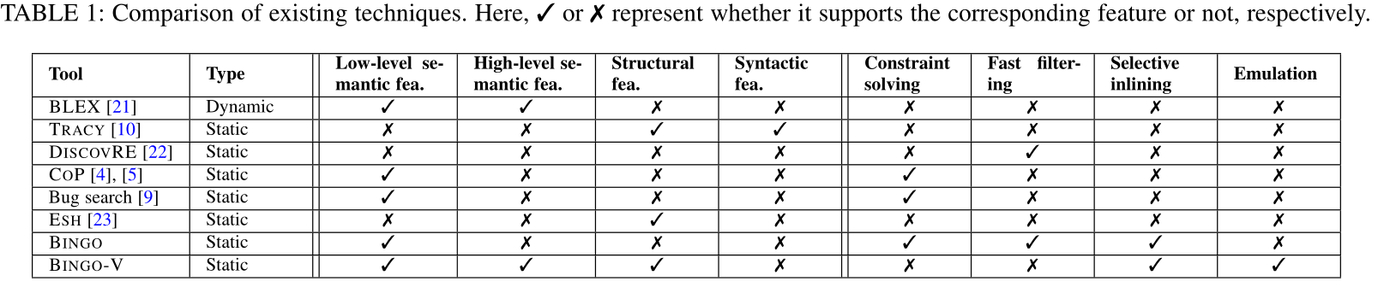
Problem with Existing Tools
Not optimized (e.g., using symbolic execution)
Runs only in Linux
Has FP only using low level semantic features
Not scalable

Slide 5
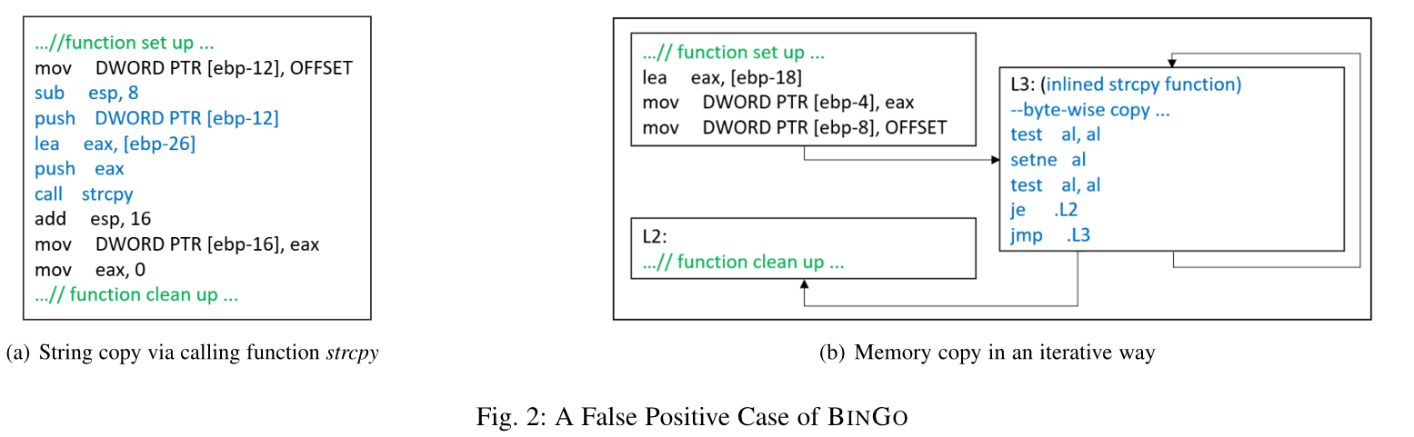
Motivation Example

Slide 6
What Is New
New scalable matching algorithm
Structural, semantic and locality-based feature extraction
Emulation functionality (Good news!)

Slide 7
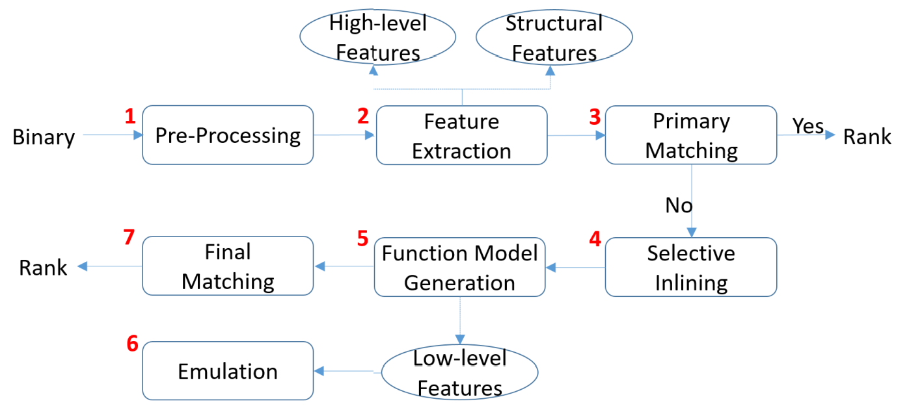
BinGo-E Architecture

Slide 8
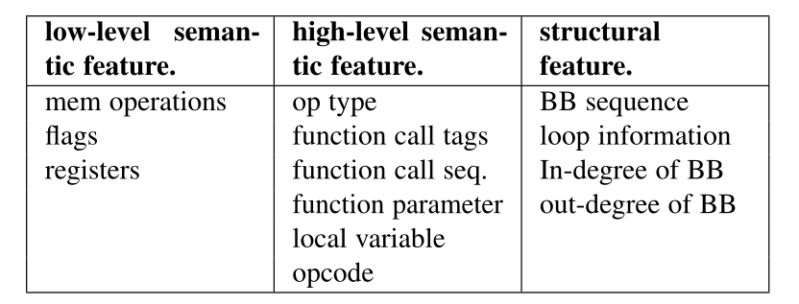
Feature Extraction
Structural features
High-level semantic features
Locality-based features
Low-level semantic features (e.g., Emulation)

Slide 9
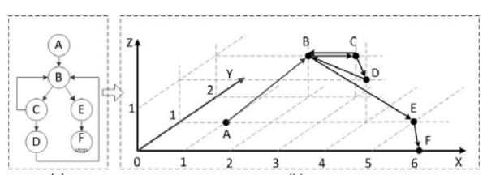
Structural Features
3D-CFG [ICSE 2013] depicts the CFG structure of a function at a high-abstraction level.
Each node has unique coordinates, denoted as a 3-tuple (x,y,z), where x is its sequential number in the CFG; y is the number of its outgoing edges (out-degree of the node in CFG), and z is the loop depth of the node.

Slide 10
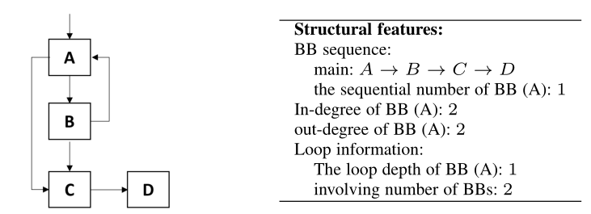
Structural Features Contd.
Basic-block sequence
Loop information
In-degree info of basic-blocks
Out-degree info of basic-blocks

Slide 11
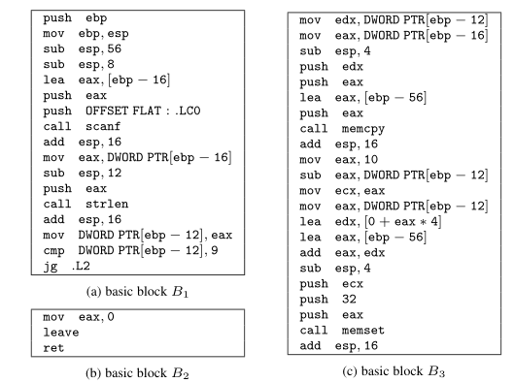
High-level Features
Instruction operation type
Function call tags
Function call sequence
Function parameter info
Function local variable info

Slide 12
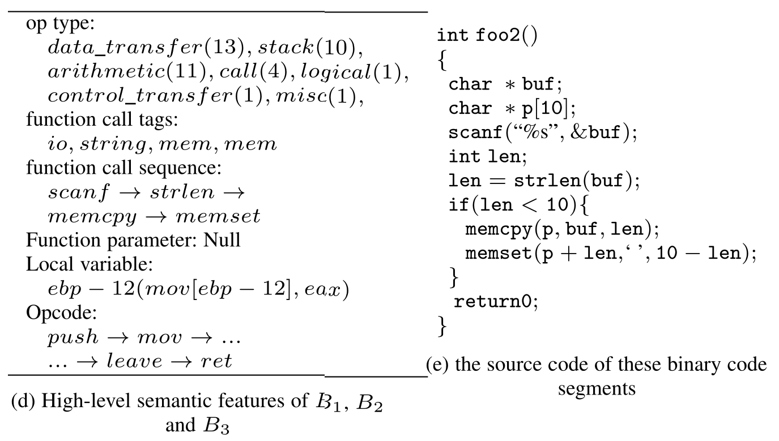
High-level Features

Slide 13
Low-level Features
1. Features originally used in Bingo
2. Newly added low level semantic features;
Values read from the program heap (denoted as “v1”)
Values written to the program heap (denoted as “v2”)
Values read from the program stack (denoted as “v3”)
Values written to the program stack (denoted as “v4”)

Slide 14
Emulation
Given input code in binary form:
Decode binary into separate instructions
Emulate exactly what each instruction does:
Instruction-Set-Architecture manual referenced is needed
Handle memory access & I/O upon requested
Update CPU context (registers/memory/etc) after each step
Example:
Instruction to emulate: ‘push eax’
load eax register
copy eax value to stack bottom
decrease esp by 4, and update esp

Slide 15
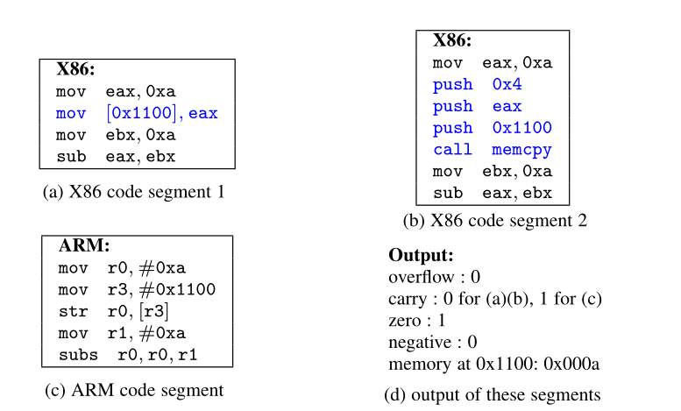
Emulation: example

Slide 16
Emulation Contd.
Key features in our Implementation
Capability to set-up stack frame
Capability to set-up heap
Capability to set-up memory segments
Global Vs. Local machine state (e.g., memory)
Persistent Vs. Non persistent memory access
Stack frame analysis
Local (i.e., stack) memory access pattern (e.g., local array)
Global (i.e., heap) memory access pattern (e.g., array, struct, etc…)

Slide 17
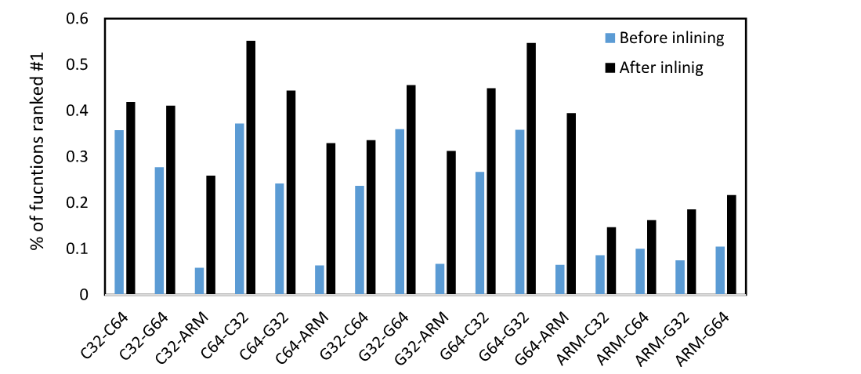
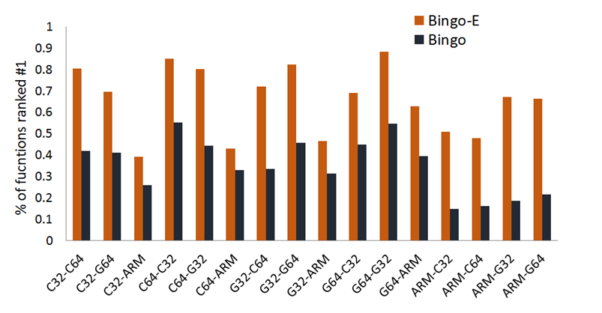
Evaluation (1)
1. Cross-architecture matching on coreutils
Bingo
Bingo-E

Slide 18
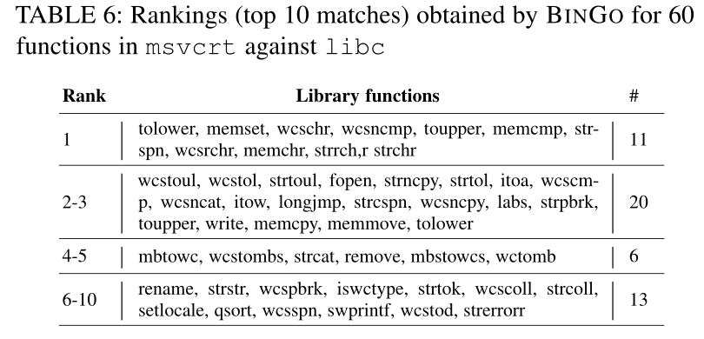
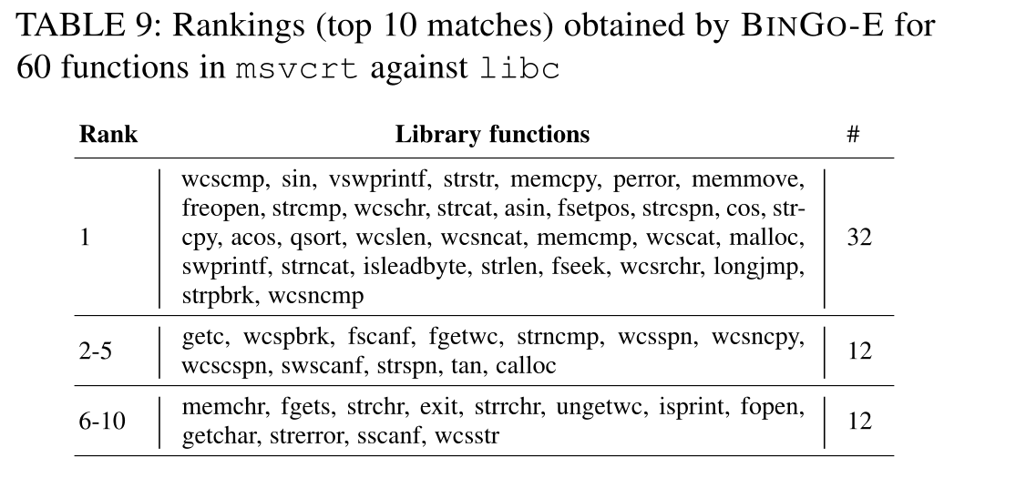
Evaluation (2)
1. Cross-OS matching on coreutils
Bingo
Bingo-E

Slide 19
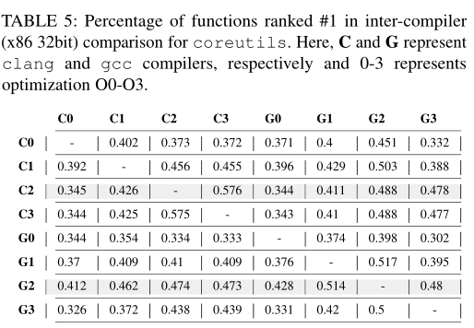
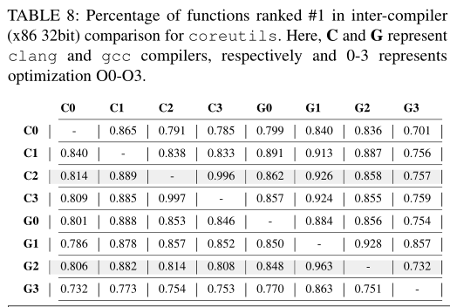
Evaluation (3)
1. Cross-Compiler matching on coreutils
Bingo
Bingo-E

Slide 20
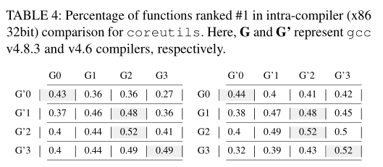
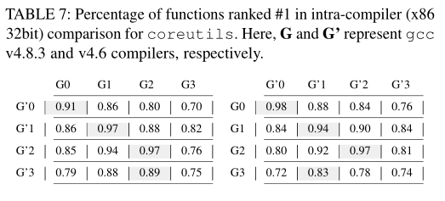
Evaluation (4)
1. Intra-Compiler matching on coreutils
Bingo
Bingo-E

Slide 21
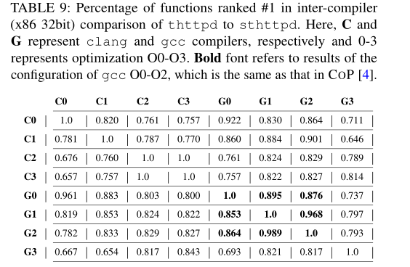
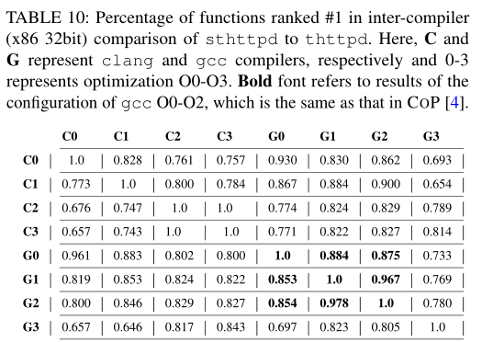
Evaluation (5)
New Application on forked projects: matching between thttpd-2.25b and sthttpd-2.26.4
Bingo-E
Bingo-E

Slide 22
Scalability and Results
1 million function matching can be done in 35 seconds without any parallelization.
Fast emulation: took 0.5 second to emulate a function with 193 basic-blocks
Matching accuracy in improved by more than 30% compare to our precious work.

Slide 23
Q&A
THANK YOU! ☺
Feedback and Suggestions?

